Slide 1



Market Research & GTM Strategy for SkyServe GeoRisk
SkyServe GeoRisk provides comprehensive geographic risk insights for various sectors, including finance, insurance, real estate, and government agencies.
by Anand

Slide 2

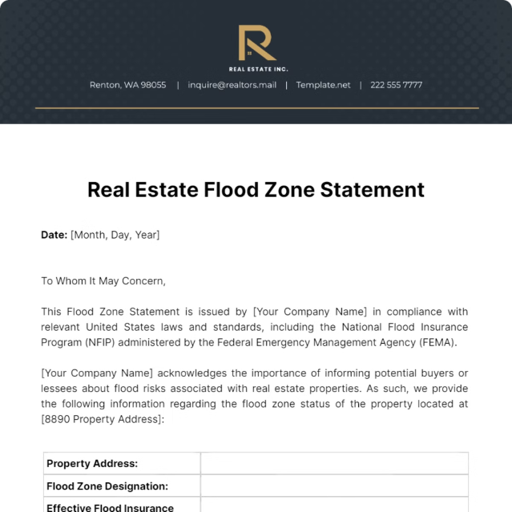
Introduction to SkyServe GeoRisk
SkyServe GeoRisk offers real-time geographic risk data for sectors such as finance, insurance, real estate, and government agencies.
Real-time Data
Provides real-time insights on risk factors like flooding, seismic zones, lakebed encroachment, and property accessibility.
Informed Decision-Making
Empowers stakeholders to make informed decisions based on comprehensive risk assessments.

Slide 3
Market Research Overview
SkyServe GeoRisk targets various segments, including finance and insurance, real estate developers, government and municipalities, environmental regulatory agencies, and end users.
Finance & Insurance
Real Estate Developers
Government & Environmental Agencies
Provides risk assessment tools for financial institutions and insurance companies.
Offers data for informed land acquisition, development, and risk mitigation.
Supports disaster risk management, urban planning, and environmental protection initiatives.

Slide 4


Lead Identification
SkyServe GeoRisk identifies target companies and organizations within each segment.
1
Finance/Insurance
HDFC, ICICI, Tata AIG
2
Real Estate
DLF, Godrej Properties, CBRE
3
Government
Ministry of Urban Development, Disaster Management Authorities
4
Environmental
WWF, State Environment Boards

Slide 5


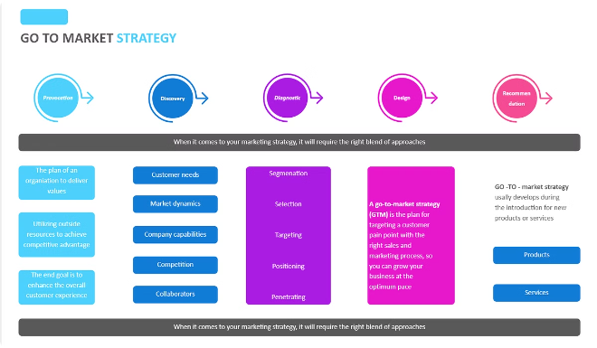



Go-To-Market Strategy
SkyServe GeoRisk employs a segment-specific GTM strategy to reach its target audience.
Finance & Insurance
Custom demos, API integration
Real Estate
Targeted outreach, data visualization
Government & Environmental Agencies
Public tenders, collaborations
End Users
Partnerships with real estate platforms (e.g., Zillow, MagicBricks)

Slide 6

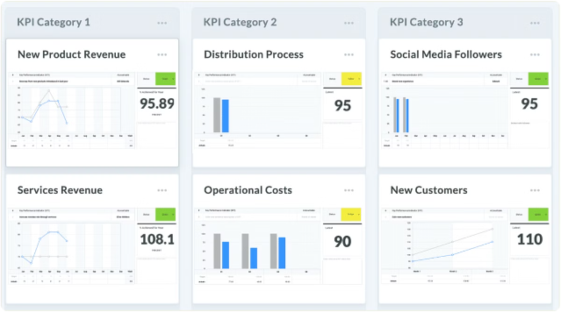
Metrics for Tracking Success
SkyServe GeoRisk tracks key metrics to measure the success of its GTM strategy.
Customer Acquisition
Leads, Conversion Rate, CAC
Customer Engagement
API usage, Retention, Churn
Sales Performance
Revenue growth, Deal size
Marketing Performance
CTR, CLV, ROI

Slide 7





Conclusion
SkyServe GeoRisk's strategic approach aims to achieve significant market penetration and deliver valuable risk insights to its target audience.
Target Market Entry
SkyServe GeoRisk aims to achieve significant market penetration.
Valuable Risk Insights
Delivering comprehensive geographic risk data to its target audience.
Expected Outcomes
SkyServe GeoRisk anticipates positive outcomes from its targeted market entry.

